Slide 1
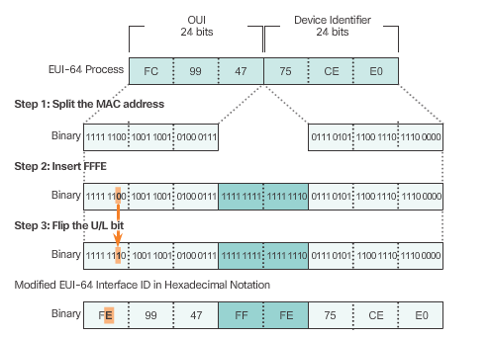
EUI-64 Process and Randomly Generated
EUI-64 Process
Notes:
7.2.4.5 EUI-64 Process and Randomly Generated (Cont.)

Slide 2
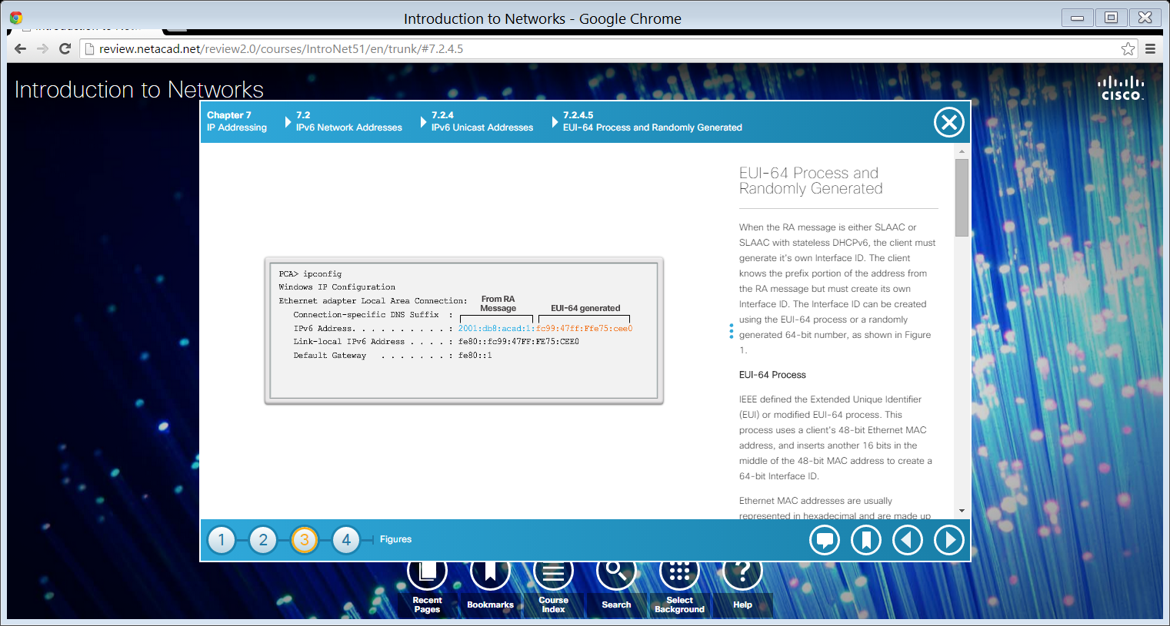
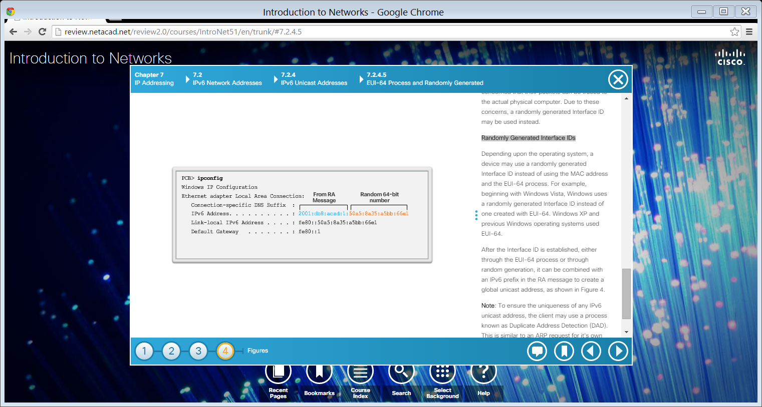
EUI-64 Process and Randomly Generated
EUI-64 Process
Randomly Generated Interface ID
Notes:
7.2.4.5 EUI-64 Process and Randomly Generated (Cont.)

Slide 3
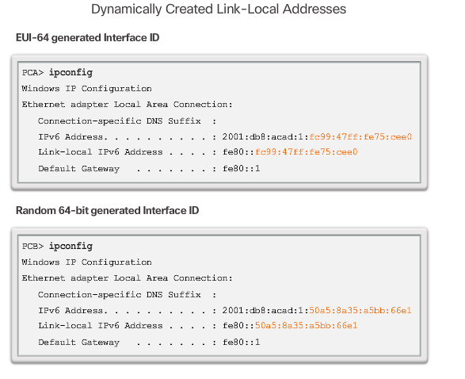
Dynamic Link-Local Addresses
Notes:
7.2.4.6 Dynamic Link-Local Addresses

Slide 4

Dynamic Link-Local Addresses (cont.)
Notes:
7.2.4.6 Dynamic Link-Local Addresses (Cont.)

Slide 5
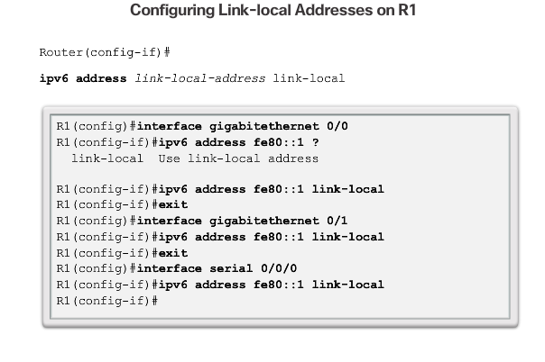
Static Link-Local Addresses
Notes:
7.2.4.7 Static Link-Local Addresses

Slide 6
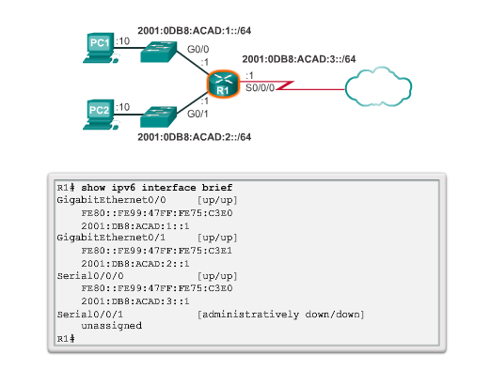
Verifying IPv6 Address Configuration
Notes:
7.2.4.8 Verifying IPv6 Address Configuration

Slide 7
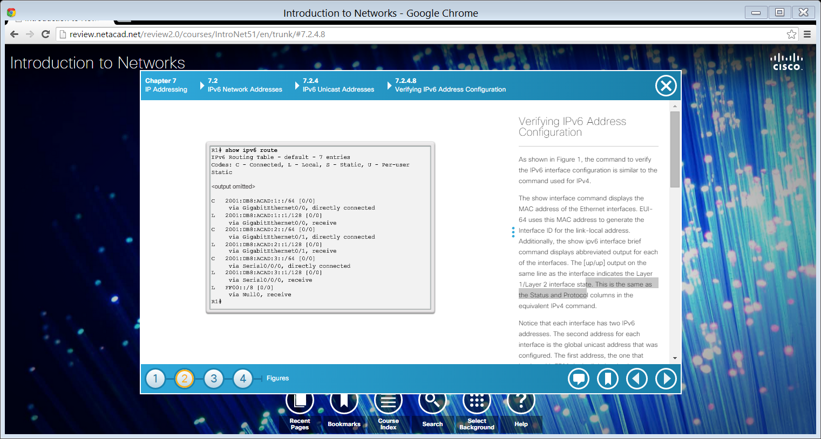
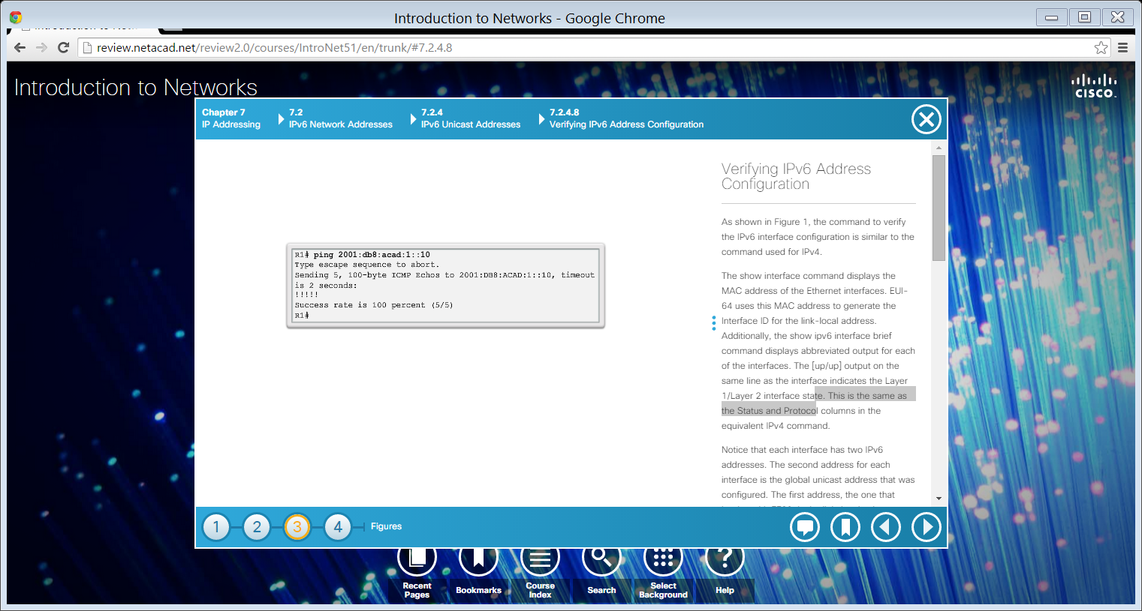
Verifying IPv6 Address Configuration (cont.)
Notes:
7.2.4.8 Verifying IPv6 Address Configuration (Cont.)
7.2.4.9 Packet Tracer – Configuring IPv6 Addressing

Slide 8
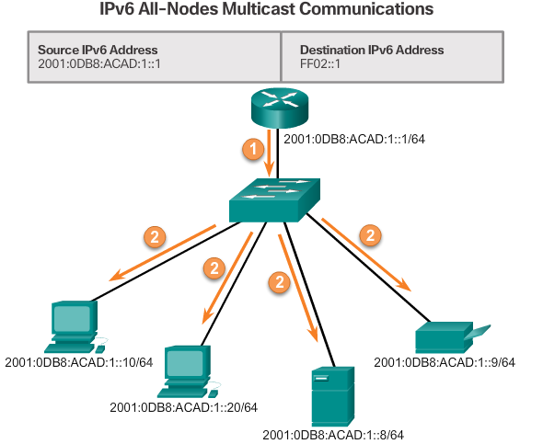
Assigned IPv6 Multicast Addresses
IPv6 multicast addresses have the prefix FF00::/8.
There are two types of IPv6 multicast addresses:
Assigned multicast
Solicited node multicast
Notes:
7.2.5.1 Assigned IPv6 Multicast Addresses

Slide 9
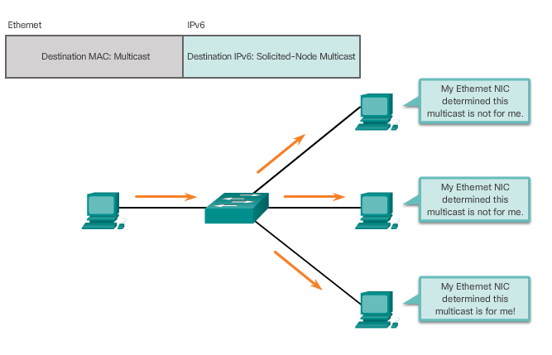
Solicited-Node IPv6 Multicast Addresses
Notes:
7.2.5.2 Solicited-Node IPv6 Multicast Addresses
7.2.5.3 Lab – Identifying IPv6 Addresses
7.2.5.4 Lab – Configuring IPv6 Addresses on Network Devices

Slide 10
Section 7.3: Connectivity Verification
Upon completion of this section, you should be able to:
Explain how ICMP is used to test network connectivity.
Use ping and traceroute utilities to test network connectivity.

Slide 11
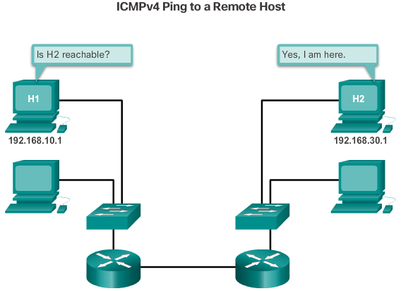
ICMPv4 and ICMPv6
Notes:
7.3.1.1 ICMPv4 and ICMPv6

Slide 12
ICMPv4 and ICMPv6 (cont.)
ICMP messages common to both ICMPv4 and ICMPv6 include:
Host confirmation
Destination or service unreachable
Time exceeded
Route redirection
Although IP is not a reliable protocol, the TCP/IP suite provides for messages to be sent in the event of certain errors. They are sent using the services of ICMP.
Notes:
7.3.1.1 ICMPv4 and ICMPv6 (Cont.)

Slide 13
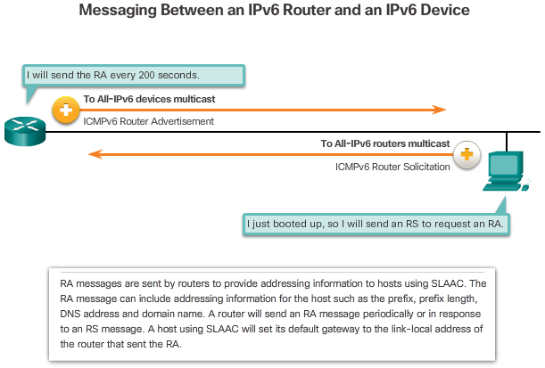
ICMPv6 Router Solicitation and Router Advertisement Messages
Notes:
7.3.1.2 ICMPv6 Router Solicitation and Router Advertisement Messages

Slide 14
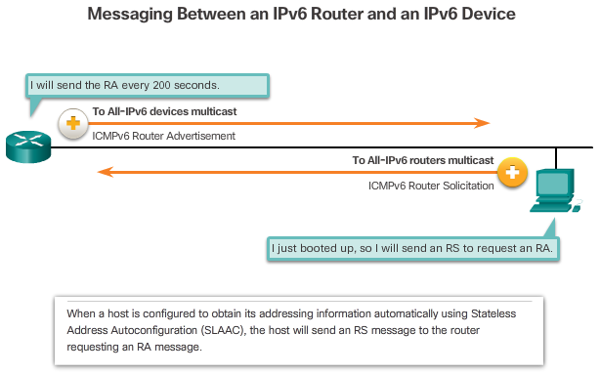
ICMPv6 Router Solicitation and Router Advertisement Messages
Notes:
7.3.1.2 ICMPv6 Router Solicitation and Router Advertisement Messages (Cont.)

Slide 15
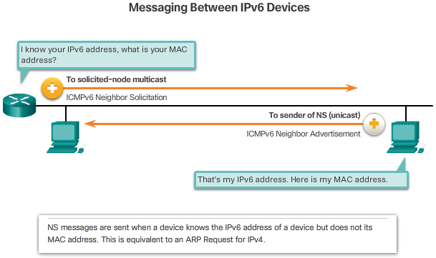
ICMPv6 Router Solicitation and Router Advertisement Messages (cont.)
Notes:
7.3.1.2 ICMPv6 Router Solicitation and Router Advertisement Messages (Cont.)

Slide 16
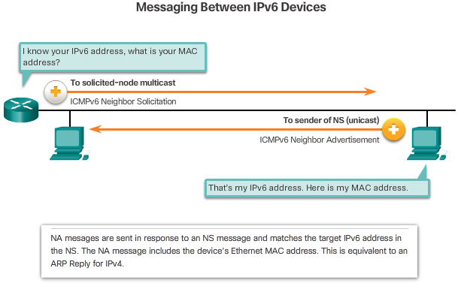
ICMPv6 Router Solicitation and Router Advertisement Messages (cont.)
Notes:
7.3.1.2 ICMPv6 Router Solicitation and Router Advertisement Messages (Cont.)

Slide 17
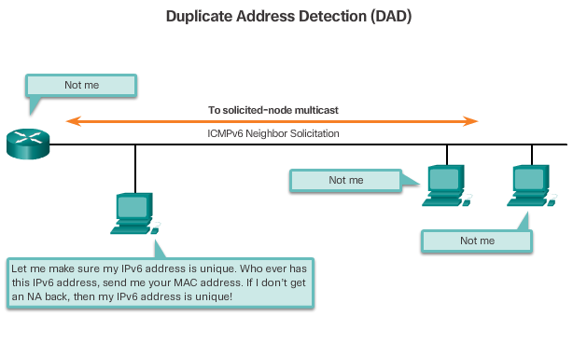
ICMPv6 Router Solicitation and Router Advertisement Messages (cont.)
Notes:
7.3.1.2 ICMPv6 Router Solicitation and Router Advertisement Messages (Cont.)

Slide 18
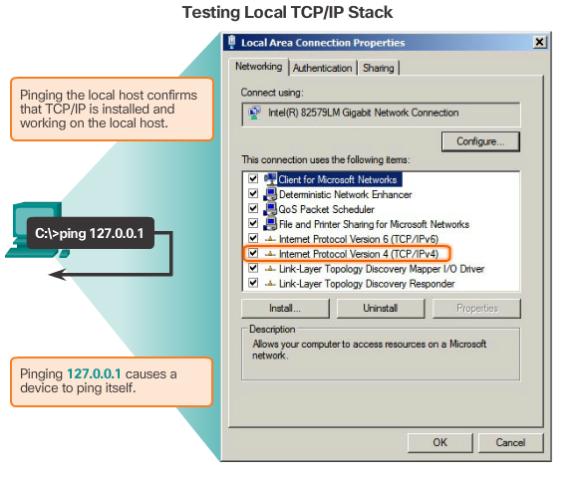
Ping - Testing the Local Stack
Notes:
7.3.2.1 Ping - Testing the Local Stack

Slide 19
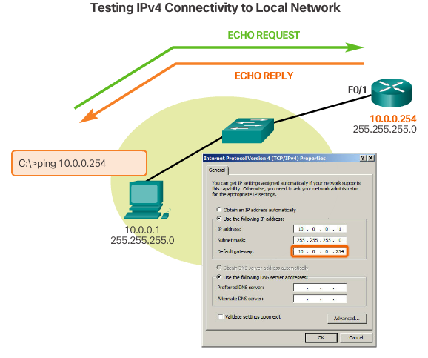
Ping – Testing Connectivity to the Local LAN
Notes:
7.3.2.2 Ping – Testing Connectivity to the Local LAN

Slide 20
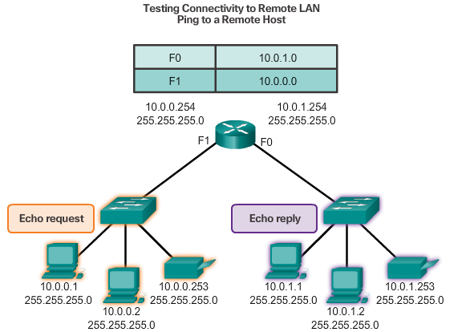
Ping – Testing Connectivity to Remote
Notes:
7.3.2.3 Ping – Testing Connectivity to Remote

Slide 21
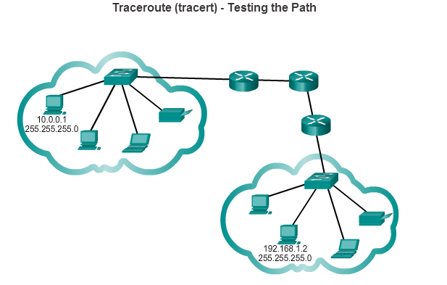
Traceroute – Testing the Path
Notes:
7.3.2.4 Traceroute – Testing the Path
7.3.2.5 Packet Tracer – Verifying IPv4 and IPv6 Addressing
7.3.2.6 Packet Tracer – Pinging and Tracing to Test the Path
7.3.2.7 Lab – Testing Network Connectivity with Ping and Traceroute
7.3.2.8 Lab – Mapping the Internet
7.3.2.9 Packet Tracer – Troubleshooting IPv4 and IPv6 Addressing

Slide 22
Section 7.4: Summary
Chapter Objectives:
Explain the use of IPv4 addresses to provide connectivity in a small to medium-sized business network.
Configure IPv6 addresses to provide connectivity in small to medium-sized business networks.
Use common testing utilities to verify network connectivity.
Notes:
7.4.1.1 Class Activity – The Internet of Everything…Naturally!
7.4.1.2 Packet Tracer – Skills Integration Challenge
7.4.1.3 Chapter 7: IP Addressing

